Slide 1
Image Registration
Haris Jeelani

Slide 2
Agenda
Optical Flow to Demons Registration Equation.
Multi-modality Transformation.
Results.

Slide 3
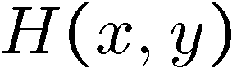
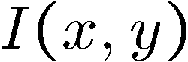
Optical Flow
How to estimate pixel motion from image H to image I?
Key assumptions
color constancy: a point in H looks “the same” in image I
For grayscale images, this is brightness constancy
small motion: points do not move very far

Slide 4
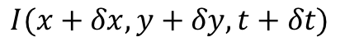
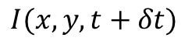
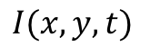
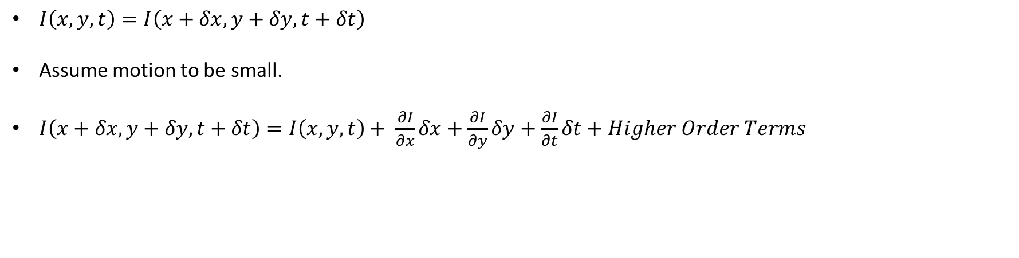
Contd ..
Optical Flow equation is basis of demon registration forces.
$$I(x+δx,y+δy,t+δt)$$
$$I(x,y,t)$$
$$I(x,y,t+δt)$$
$I\left(x,y,t\right)=I\left(x+δx, y+δy, t+δt\right)$
Assume motion to be small.
$I\left(x+δx,y+δy,t+δt\right)=I\left(x, y, t\right)+ \frac{∂I}{∂x}δx+\frac{∂I}{∂y}δy+\frac{∂I}{∂t}δt+Higher Order Terms$

Slide 5
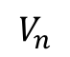
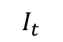
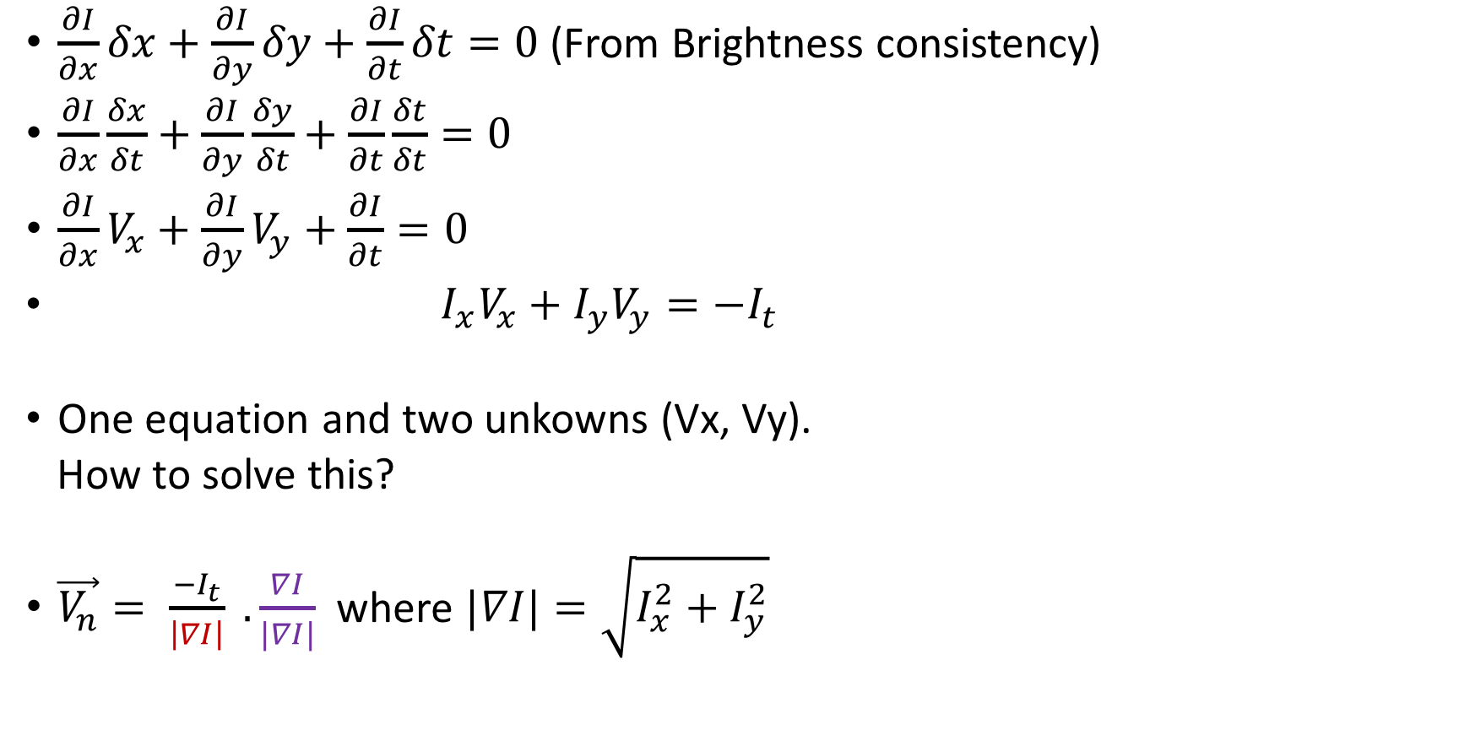
Contd ..
$\frac{∂I}{∂x}δx+\frac{∂I}{∂y}δy+\frac{∂I}{∂t}δt=0$ (From Brightness consistency)
$\frac{∂I}{∂x}\frac{δx}{δt}+\frac{∂I}{∂y}\frac{δy}{δt}+\frac{∂I}{∂t}\frac{δt}{δt}=0$
$\frac{∂I}{∂x}V_{x}+\frac{∂I}{∂y}V_{y}+\frac{∂I}{∂t}=0$
$I_{x}V_{x}+I_{y}V_{y}=−I_{t}$
One equation and two unkowns (Vx, Vy).
How to solve this?
$\vec{V_{n}}= \frac{−I_{t}}{\left|∇I\right|} .\frac{∇I}{|∇I|}$ where $|∇I|=\sqrt{I_{x}^{2}+I_{y}^{2}}$
Vy
$$I_{t}$$
$$V_{n}$$
Vx

Slide 6
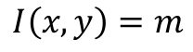
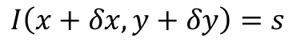
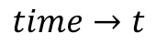
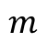
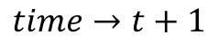
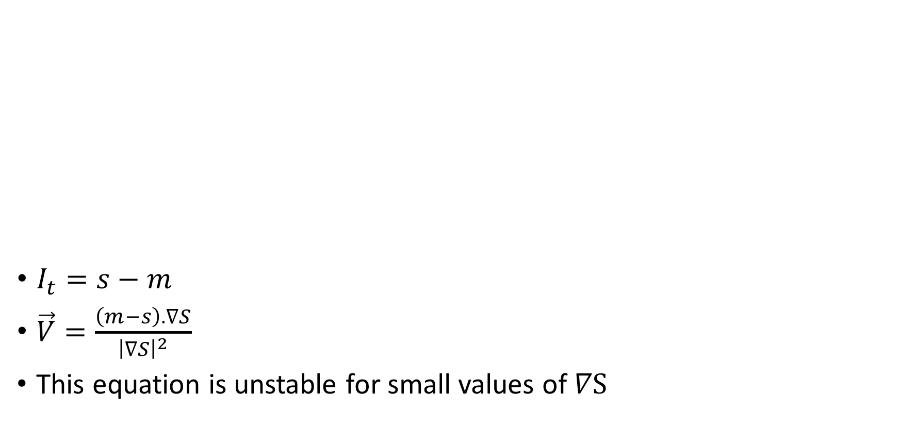
Contd …
$I_{t}=s−m$
$\vec{V}=\frac{\left(m−s\right). ∇S}{{\left|∇S\right|}^{2}}$
This equation is unstable for small values of $∇S$
$$I\left(x+δx,y+δy\right)=s$$
$$I\left(x,y\right)=m$$
$$m$$
$$time→t$$
$$time→t+1$$

Slide 7
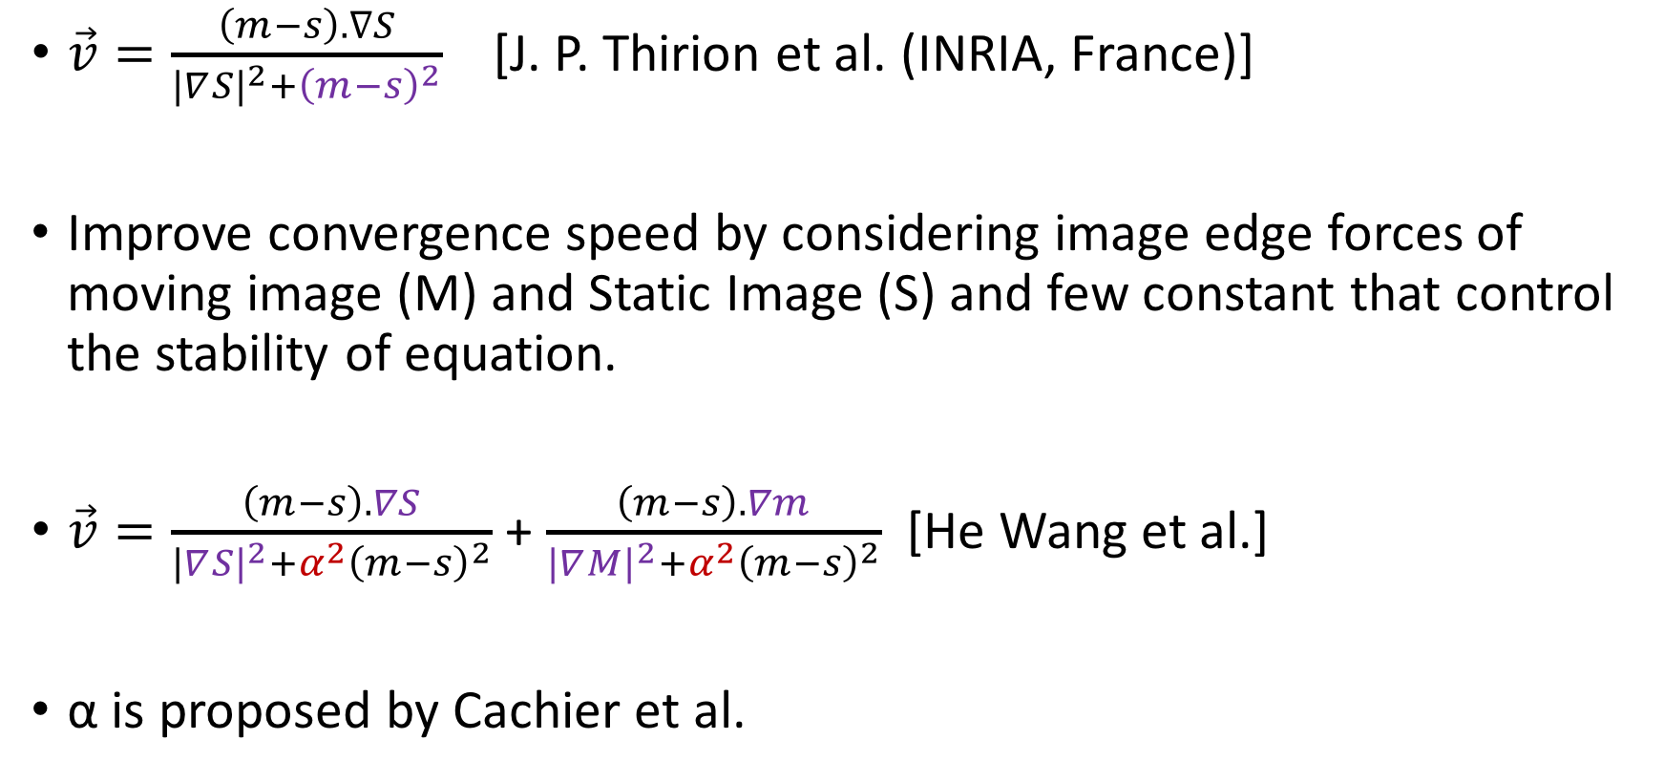
Basic Expression for Demon’s Registration
$\vec{v}=\frac{\left(m−s\right). ∇S}{|∇{S|}^{2}+{\left(m−s\right)}^{2}}$ [J. P. Thirion et al. (INRIA, France)]
Improve convergence speed by considering image edge forces of moving image (M) and Static Image (S) and few constant that control the stability of equation.
$\vec{v}=\frac{\left(m−s\right). ∇S}{|∇{S|}^{2}+{α^{2}\left(m−s\right)}^{2}}$ + $\frac{\left(m−s\right). ∇m}{|∇{M|}^{2}+{α^{2}\left(m−s\right)}^{2}}$ [He Wang et al.]
α is proposed by Cachier et al.

Slide 8
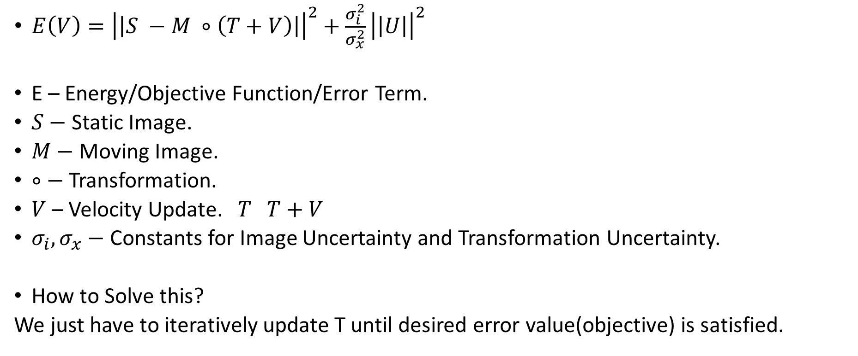
Registration Model (Not an Optimization problem)
$E\left(V\right)={\left|\left|S −M ∘\left(T+V\right)\right|\right|}^{2}+\frac{σ_{i}^{2}}{σ_{x}^{2}}{\left|\left|U\right|\right|}^{2}$
E – Energy/Objective Function/Error Term.
$S−$ Static Image.
$M−$ Moving Image.
$∘−$Transformation.
$V$ – Velocity Update. $T T+V$
$σ_{i}, σ_{x}−$ Constants for Image Uncertainty and Transformation Uncertainty.
How to Solve this?
We just have to iteratively update T until desired error value(objective) is satisfied.

Slide 9
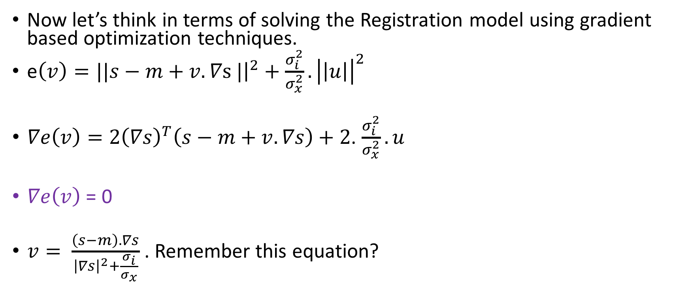
Why demons work so well?
Now let’s think in terms of solving the Registration model using gradient based optimization techniques.
e$\left(v\right)=||s−m+v.∇s |{\left.​\right|}^{2}+\frac{σ_{i}^{2}}{σ_{x}^{2}}.{\left|\left|u\right|\right|}^{2}$
$∇e\left(v\right)=2{\left(∇s\right)}^{T}\left(s−m+v.∇s\right)+2$. $\frac{σ_{i}^{2}}{σ_{x}^{2}}.u$
$∇e\left(v\right)$ = 0
$v= \frac{\left(s−m\right). ∇s}{{\left|∇s\right|}^{2}+\frac{σ_{i}}{σ_{x}}}$ . Remember this equation?

Slide 10
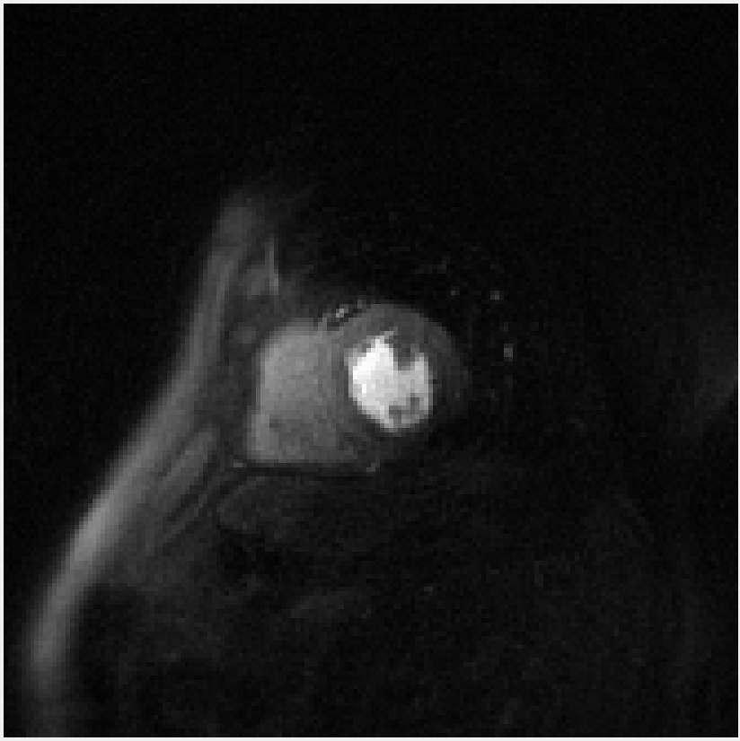
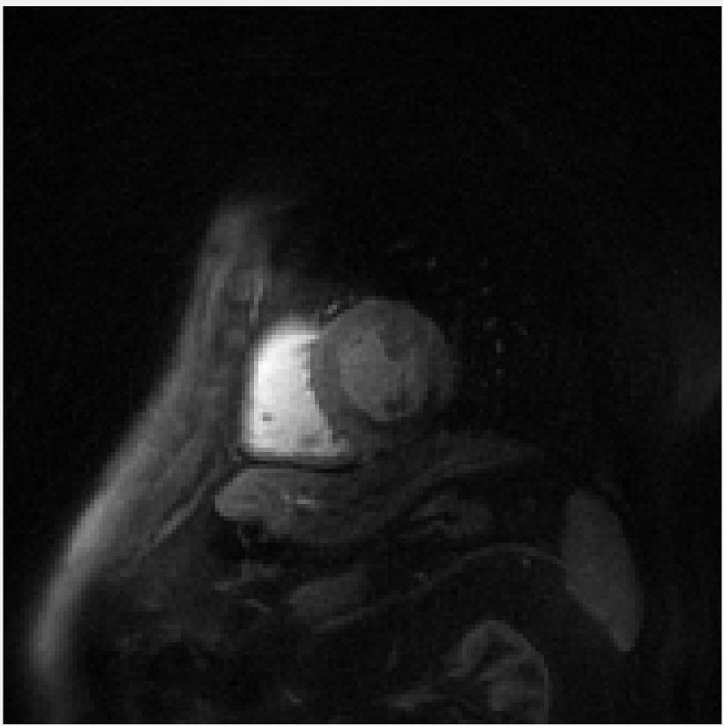
Cannot be used in cardiac Perfusion MRI

Slide 11
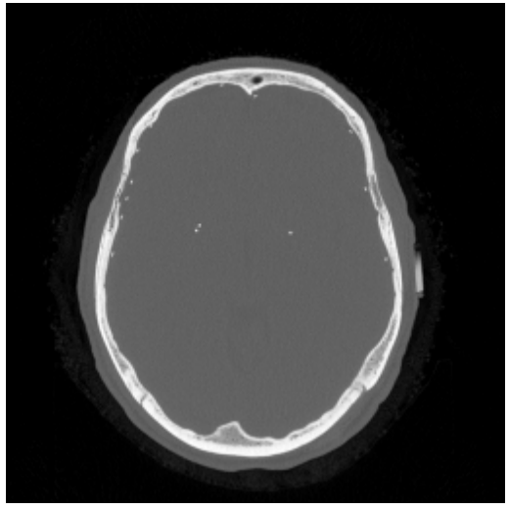
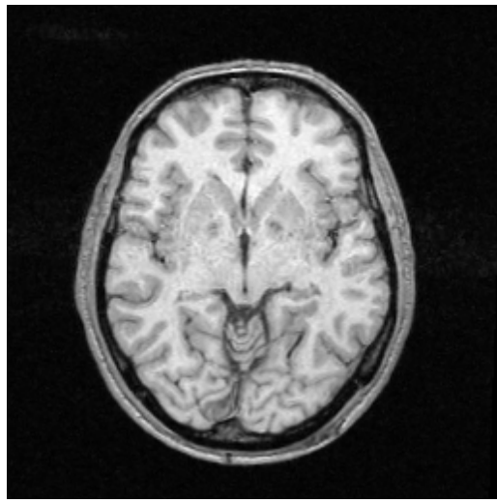
More General Example (CT to MR):
One solution is to figure out some transformation that gives unique(not exactly) to both images.
Looking at a Feature Space should give us some insights.
Ref: Josien P. W. Pluim

Slide 12
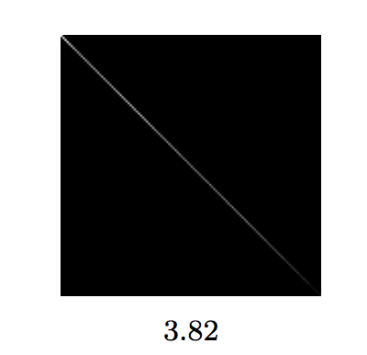
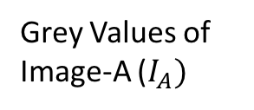
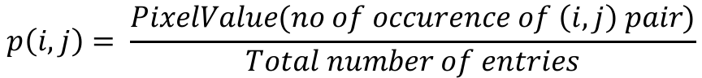
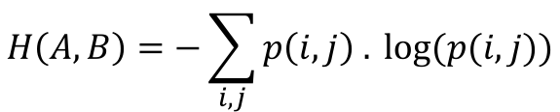
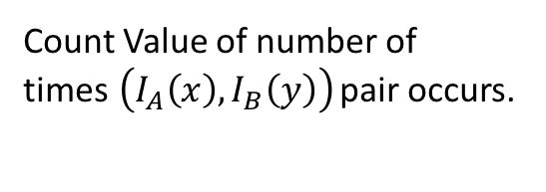
Joint Histogram/Feature Space
Simple Example:
Grey Values of Image-B
Count Value of number of times$\left(I_{A}\left(x\right),I_{B}\left(y\right)\right)$ pair occurs.
This is one of the ways of generating the Histogram.
Grey Values of Image-A ($I_{A})$
$$p\left(i,j\right)= \frac{PixelValue(no of occurence of \left(i,j\right) pair)}{Total number of entries}$$
$$H\left(A,B\right)=−\sum_{i,j}{p\left(i,j\right) . log⁡(p(i,j))}$$

Slide 13
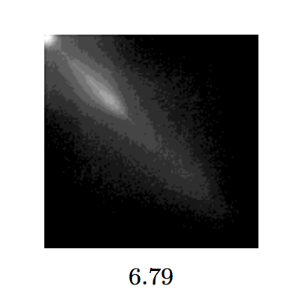
After rotation
Joint Histogram from previous example.
Which image would you choose?

Slide 14
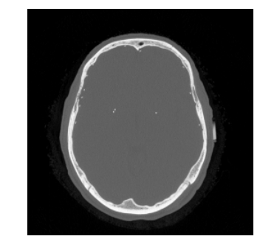
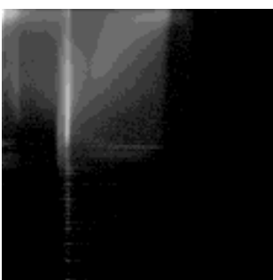
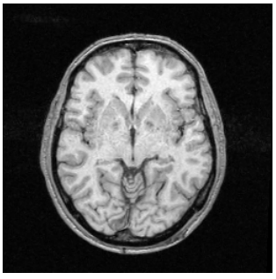
Back to CT to MRI
MR pixels
CT pixels
One pixel value in MR is matching with many pixel values in CT image.
Iteratively find best rotations/interpolation until entropy is minimized along a particular column (corresponds to anatomical structure).

Slide 15
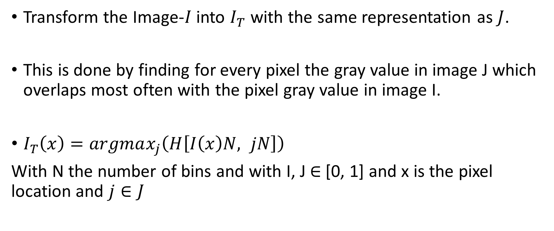
Modality Transform
Transform the Image-$I$ into $I_{T}$ with the same representation as $J$.
This is done by finding for every pixel the gray value in image J which overlaps most often with the pixel gray value in image I.
$I_{T}\left(x\right)=argmax_{j}\left(H\left[I\left(x\right)N, jN\right]\right)$
With N the number of bins and with I, J $∈$[0, 1] and x is the pixel location and $j∈J$

Slide 16
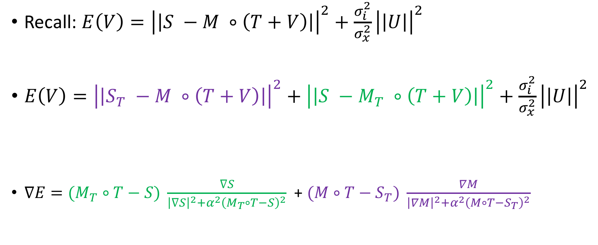
Rewriting the Registration Model
Recall: $E\left(V\right)={\left|\left|S −M ∘\left(T+V\right)\right|\right|}^{2}+\frac{σ_{i}^{2}}{σ_{x}^{2}}{\left|\left|U\right|\right|}^{2}$
$E\left(V\right)={\left|\left|S_{T} −M ∘\left(T+V\right)\right|\right|}^{2}+{\left|\left|S −M_{T} ∘\left(T+V\right)\right|\right|}^{2}+\frac{σ_{i}^{2}}{σ_{x}^{2}}{\left|\left|U\right|\right|}^{2}$
$∇E{=(M}_{T} ∘T−S) \frac{∇S}{{\left|∇S\right|}^{2}+α^{2}{\left(M_{T}∘T−S\right)}^{2}}$ + $(M∘T−S_{T}) \frac{∇M}{{\left|∇M\right|}^{2}+α^{2}{\left(M∘T−S_{T}\right)}^{2}}$
Transformed into M
Transformed into S

Slide 17
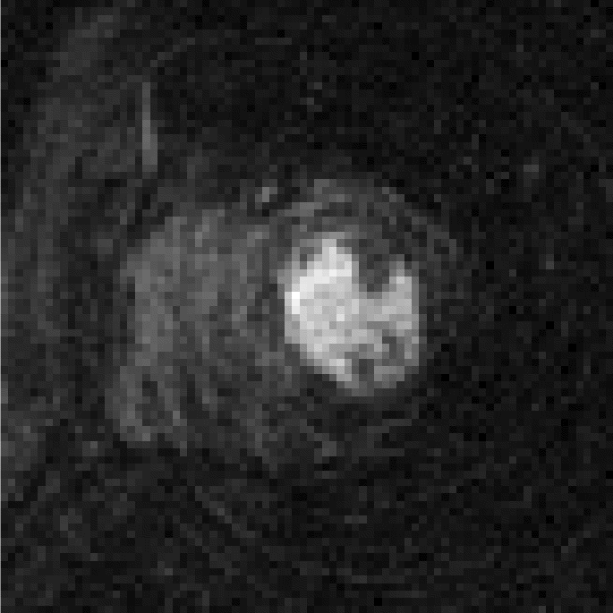
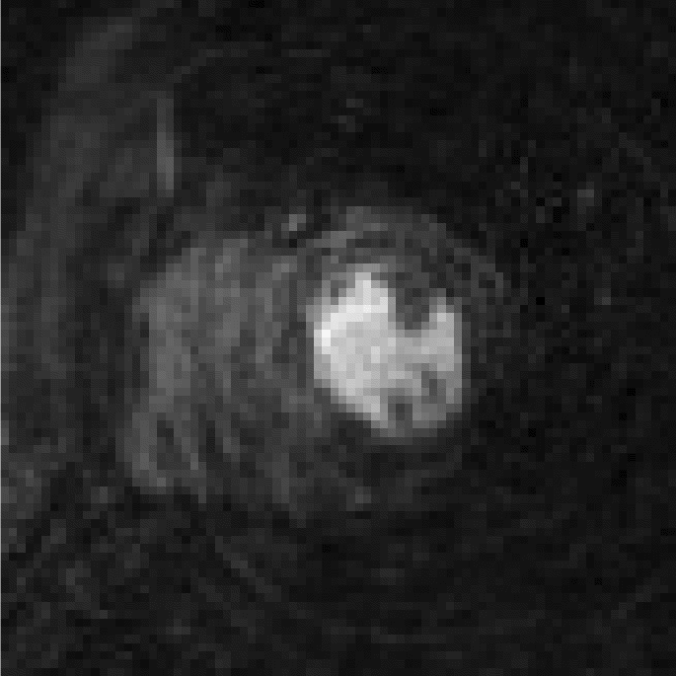
Results (Without Compressed Sensing)

Slide 18
Summary
Derived a Demon’s Registration model from Optical Flow equation.
Derivative of a Error Term is similar to velocity equation used in Demon’s algorithm.
How to use this model when static and the moving image have different contrast (Modality Transform).
Registration of cardiac perfusion of images to a reference image.

